Slide 1
TODAY:
Your task:
To complete in one lesson – all of the materials you need to use in a crime campaign
Remember – logo and print materials; merchandise (X3; and social media posts)
This campaign must be on:
Hate Crime (race, gender, belief, sexual orientation, gender identity)
And remember, your campaign needs a strong SLOGAN

Slide 2
CRIME CATEGORIES
White Collar Crimes (Defrauding customers; Tax Evasion; Breaking health and safety law; Polluting the Environment)
Technological Crime (Catfishing; Identity Theft; Online Hate crimes; Illegal Downloading; Online Grooming; Phising; Romance Fraud)
State Crime (Genocide; Torture; Police brutality; War Crimes; Political Crimes e.g. election fraud)
Hate Crime (Racist Abuse, Transphobia, Islamophobia; Disability Crimes)
Domestic Abuse (Coercive Control, Financial Abuse; Domestic Violence)
Honour Crime (forced marriage, FGM)
Moral Crime (Illegal Drugs Usage; Bigamy & Incest; Begging & Vagrancy; Under-age Drinking/Smoking; Prostitution; Assisted Suicide)

Slide 3
Links
Posters and Logos - CANVA.com -(https://www.canva.com)
Merchandise - T-shirt studio –(www.t-shirtstudio.com)
Social Media Tool - Zeoob - https://zeoob.com
Removing Backgrounds - BG Removal Tool (www.remove.bg/)
Writing Slogans – Magic Write – (https://www.canva.com/magic-write/)
Logos - Wix Logomaker - (https://www.wix.com/logo/maker)

Slide 4


Print Media -
POSTER
LOGO

Slide 5


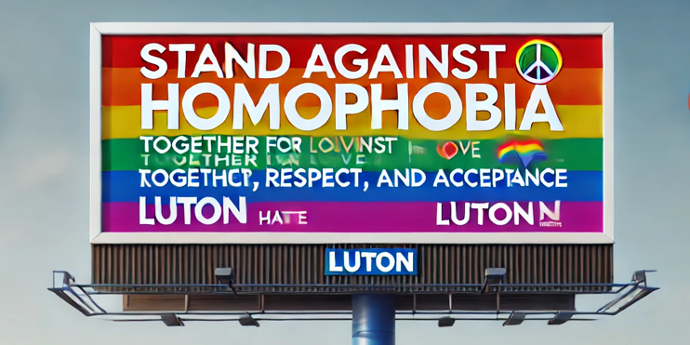
Other Print Media
FLYER
BILLBOARD

Slide 6

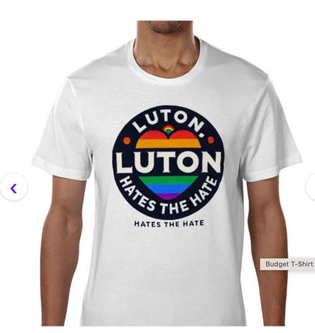

MERCHANDISE - x3
TOTE BAG
MUG
T SHIRT

Slide 7
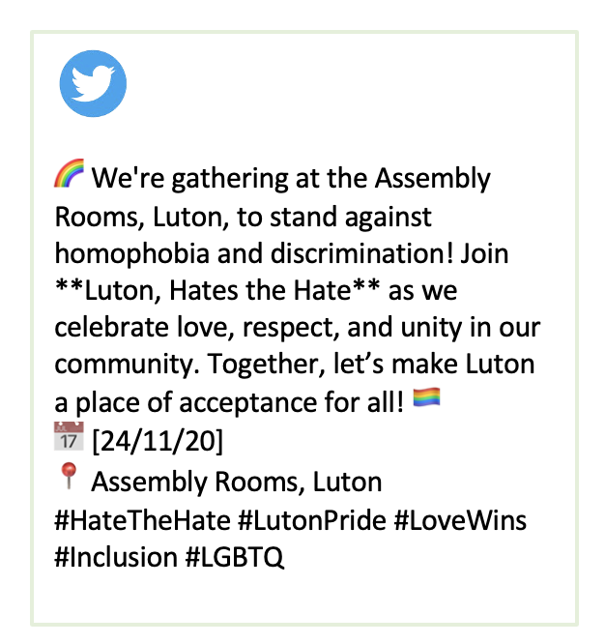
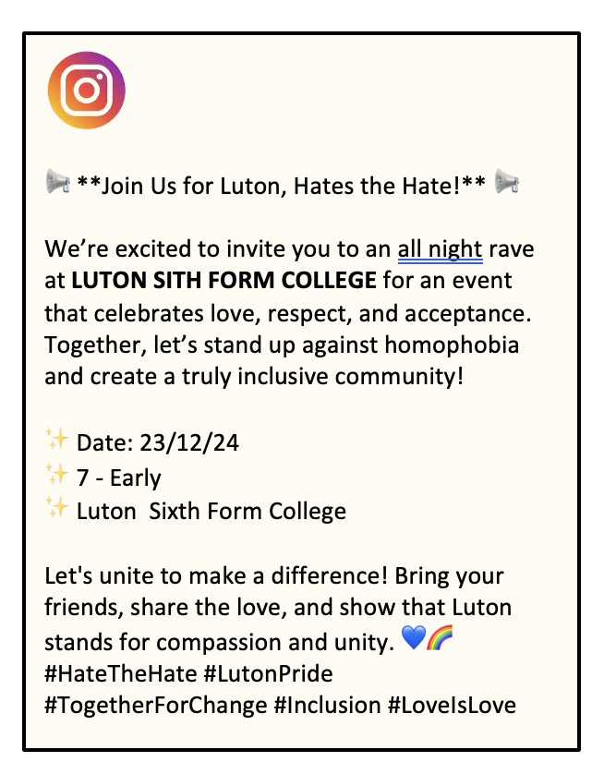
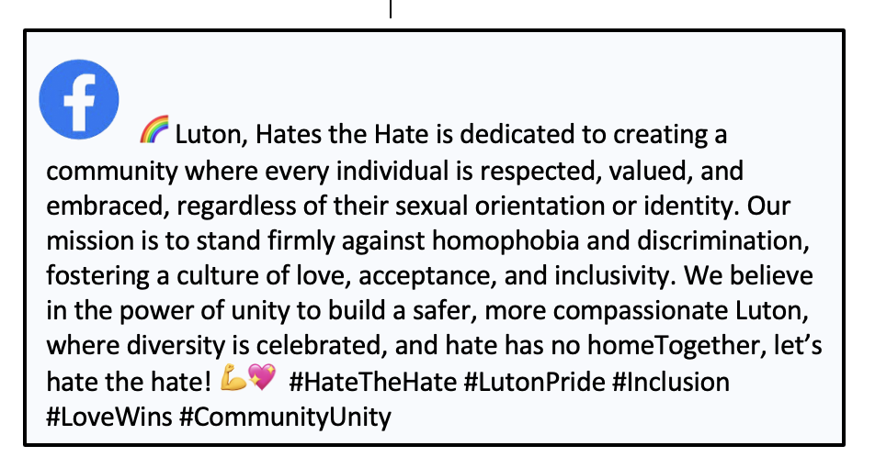
INSTAGRAM POST
🦾✔️ 1024
SOCIAL MEDIA- x3
TWITTER POST
👍 98
FADCEBOOK POST
😊🦾978

Slide 8
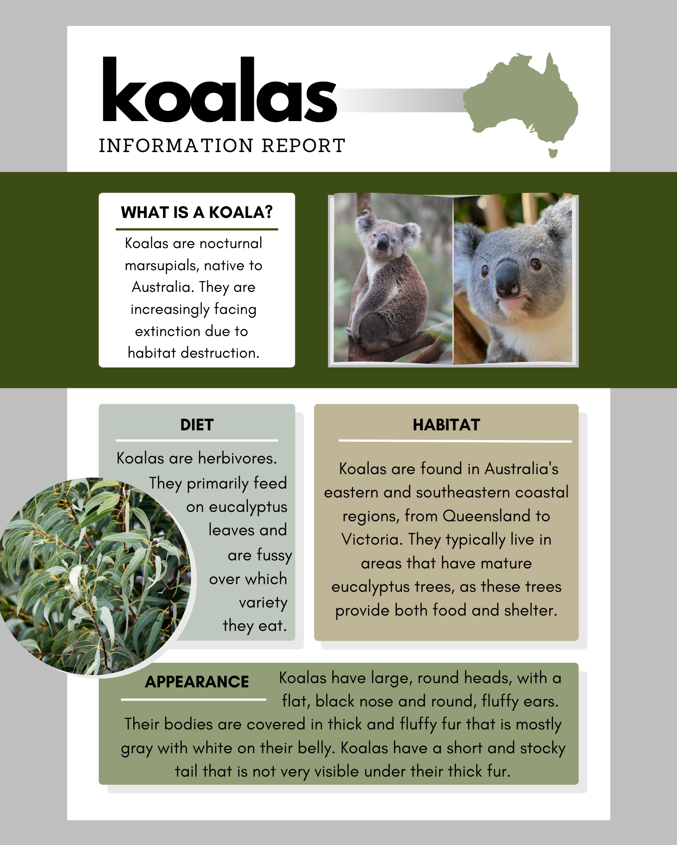

POSTER MADE ON CANVA.COM – Prep Time 10 mins (in lesson!)
It is a complete reimagining of a template – text boxes were deleted, and new colours and backgrounds were added.
4 images were added – the Black Power Fist, the Logo and the Hand-Up arms. Finally, a graphic for social media was added
All these were prepared by removing the background and cropping to fit

